Slide 1
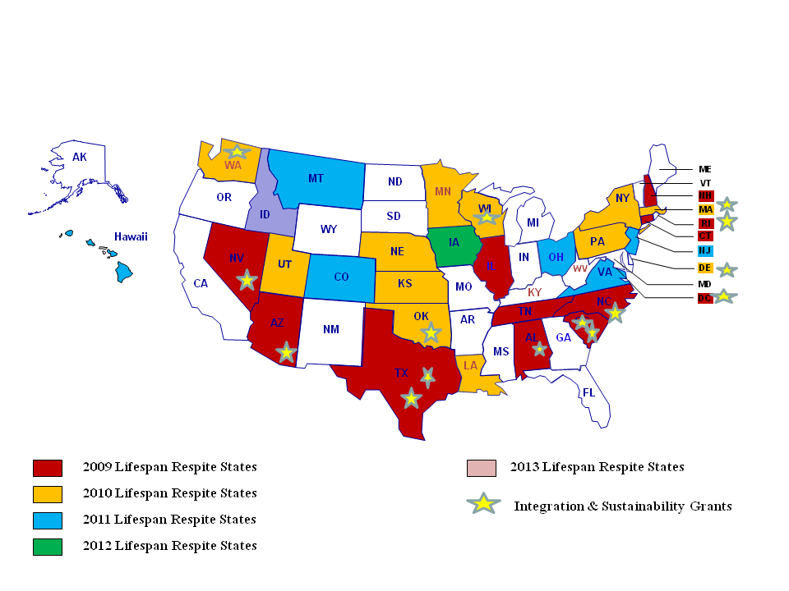
Lifespan Respite Systems:
Building Bridges to Family Support
Jill Kagan, Director
ARCH National Respite Network
and Resource Center
jbkagan@verizon.net
www.archrespite.org
Background
Taking Lifespan Respite to National Scale
Current Status of Lifespan Respite Programs
What are Lifespan Respite Care Programs?
Defined by the Lifespan Respite Care Act of 2006 (PL109-442)as:
Coordinated systems of accessible, community-based respite care services for family caregivers of children or adults with special needs
Lifespan Respite Law Enacted 2006
Current Lifespan Respite Grantee States
Eligible State Lead Agency:
State agency that administers Older Americans Act;
State agency that administers Medicaid; or
Any state agency designated by the Governor
State Lead Agency Required to collaborate with:
Aging and Disability Resource Center and
State Respite Coalition or Statewide Respite Organization
Funded each year from 2009-2013 at $2.5 million
Respite: The Challenges
Multiple Programs
Multiple Entry Points
Limited Providers
Lack of Caregiver Awareness
Multiple Funding Sources
Federal Program Implementation
Administration for Community Living/Administration on Aging
awards grants to state agencies on a competitive basis
32 States and DC funded between 2009 & 2013 with initial
grants up to $200,000 for three year projects, followed by
Integration and Sustainability grants for select states.
Lifespan Respite Grantee Activities
Environmental Scans/Needs Assessments
Defining Stakeholder Roles (ADRCs, Coalitions, Others)
Connecting ADRCs and Respite Coalitions
Public Awareness Campaigns
Website/Database Development & Expansion
Partnerships with the Faith Community
Volunteer Training and Recruitment
Respite Provision – Gap Filling
Provider Training and Recruitment
Emergency Respite
Characteristics of Lifespan Respite Best Practices
Identification and coordination of existing
respite resources at the state level
Identification of service gaps and creation
and monitoring of new respite services
Recruitment/training of respite providers
Connecting families to respite services,
providers, and payment resources
Promotion of public awareness about respite
Mandatory Uses of Funds
Development or enhancement of State and local Lifespan
Respite Systems
Provision of respite services (planned or emergency)
Recruitment and training of respite providers and volunteers
Information for caregivers about available respite
Assistance in gaining access to respite services
2013 Program Expansion
8 Current State Grantees & Idaho Funded
Builds on Existing Projects
Performance Measurement and Sustainability Focused
Key Expansion Activities:
Vouchers/Affordable Respite Options
Quality Measures
Enhance Consumer Choice and Control
Standardize Referral Protocols
Formalize and Target Marketing Strategies
Grow and Strengthen Coalitions
Original Lifespan Respite States
Oregon (1997)
Nebraska (1999)
Wisconsin (2000)
Oklahoma (2000)
Association of University Centers on Disabilities Conference (AUCD )2013

